Slide 1
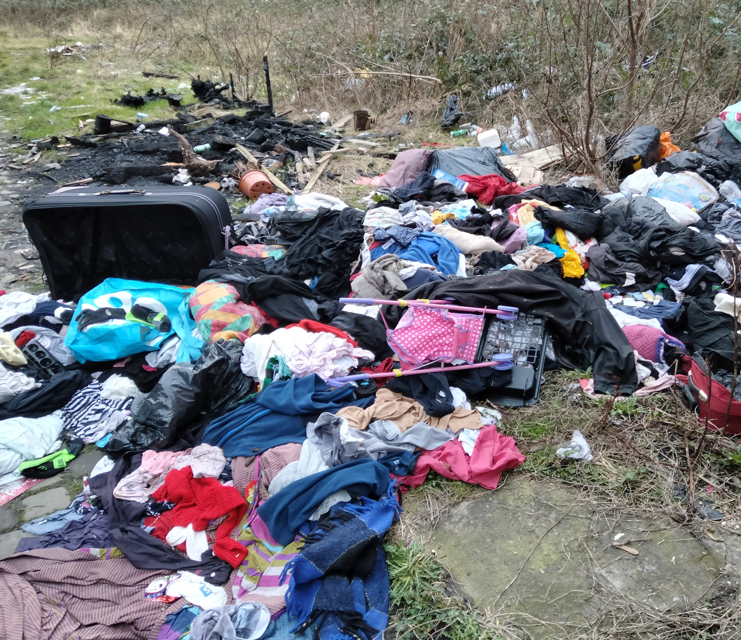
Lancaster City Council: Fly-Tipping
A. Deng, A. Holden, H. Tang, P. Kulkarni, R. Peploe & R. Noonan
Photo: Fly Tipping in West End, Morecambe from Cllr David Whitaker

Slide 2
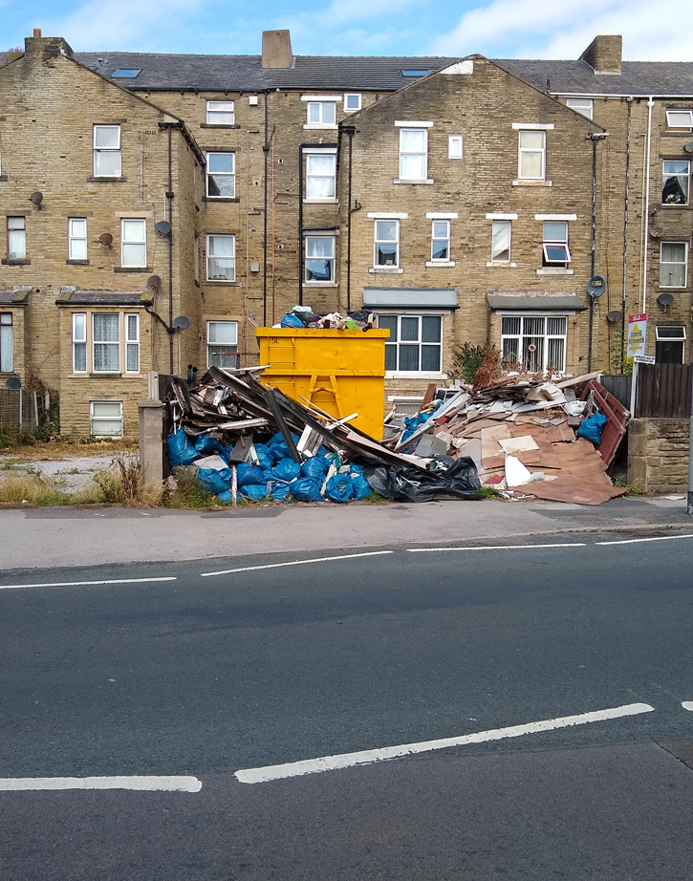
Brief
Research questions:
What are the hotspots?
What do they have in common?
Can locations be predicted?
Is there a link between the type of tipping and location?
Should there be areas which enforcement officers pay particular attention?
Photo: Fly Tipping in Heysham North, from Cllr Roger Cleet

Slide 3
Research Strategy, Methods and Data Analysis Techniques Used
LOTS of exploratory analysis (tables, graphs, charts)!
Clustering
Top 4, Bottom 4 Deep Dive
Interactive map of the area
Time series forecasting

Slide 4
Data Processing
Pre-processing techniques were required with the given data, due to...
Uninformative columns (not all columns provide interesting information, i.e., Identifiers)
Missing data (i.e., dates, type of fly-tip)
Anomalous/Irrelevant data (i.e., entries from 1753)
Changed format of date/time entries (from MM/DD/YYYY to DD/MM/YYYY)
Without data pre-processing, the results of EDA could be difficult to obtain, since the techniques used rely on complete data.
Furthermore, the results of EDA could be distorted by the presence of anomalous values, providing misleading results.

Slide 5
Results (and how they relate back to the research questions)
We've mapped every single data point or, in other words, every instance of fly-tipping on an interactive map.
With these maps, we can retrieve any information about a specific case or location just by hovering over it.
There are two main advantages of these interactive maps
It is possible to use them to determine the appropriate provisions for a particular location, such as what type of bins should be used or what size of garbage collection truck is necessary based on the number of cases in the location.
In addition, we have the ability to cluster cases by location to identify which locations have a higher number of cases.

Slide 6
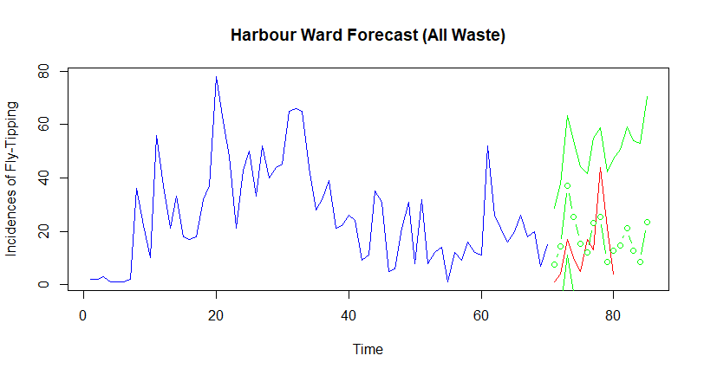
Results – Time Series Analysis

Slide 7
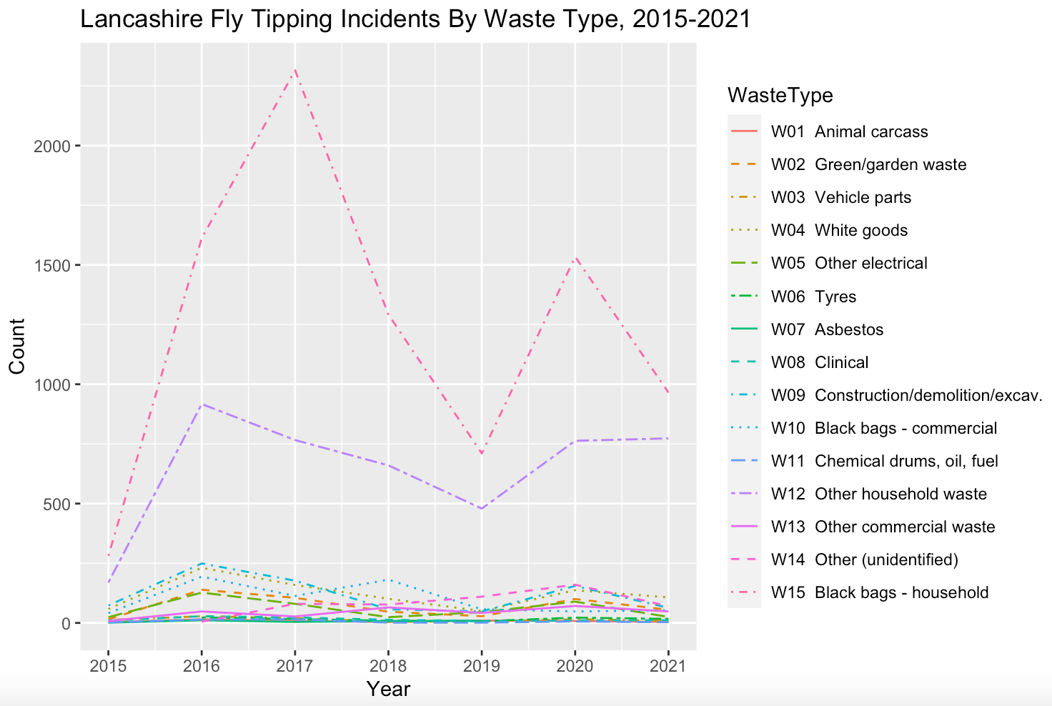
Results – Waste type between 2015 and 2021

Slide 8
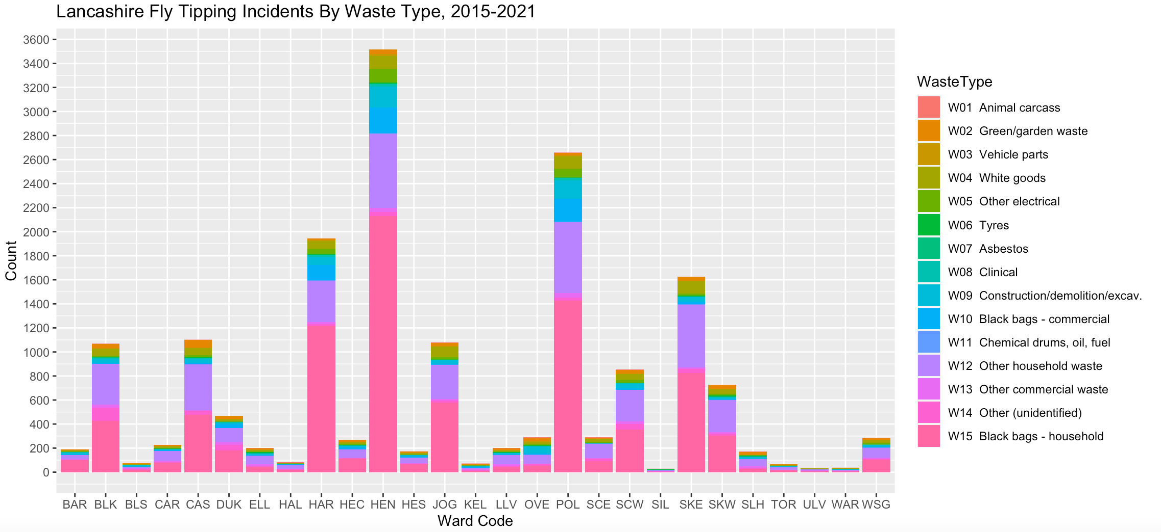
Results – Waste type by ward code

Slide 9
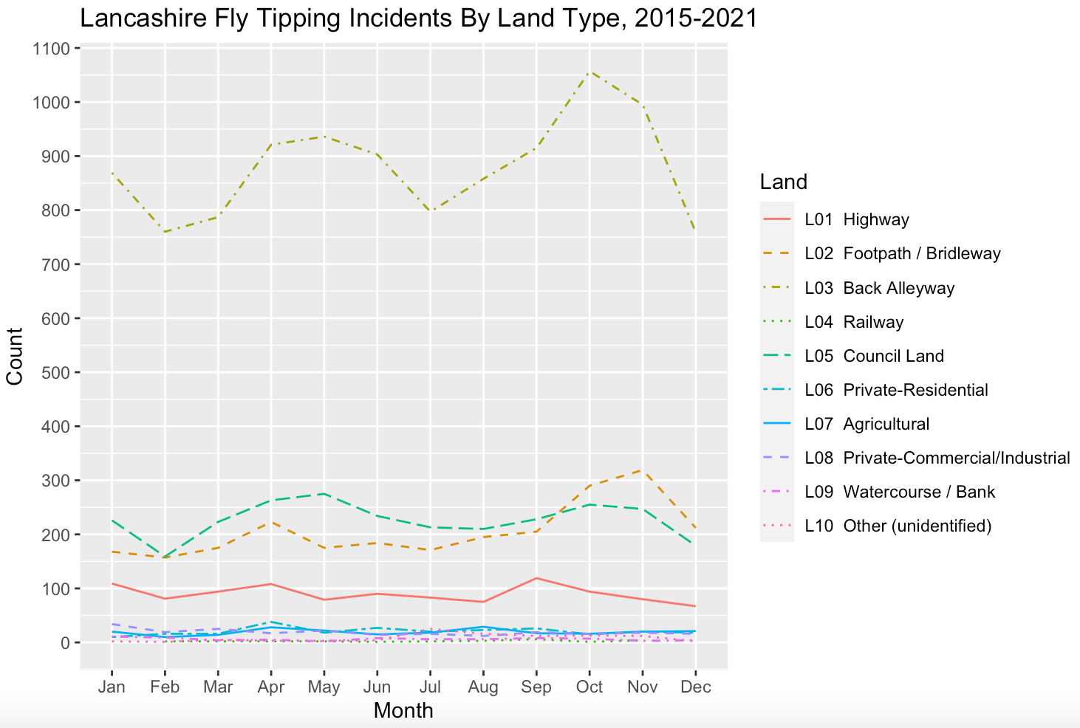
Results – Fly tipping incidents by land type

Slide 10
Results – Top 4, Bottom 4 Deep Dive
Nearby recycling sites: Morrison's & Sainsburys (Morecambe)
Nearby recycling sites: Actual recycling centers
Top 4
Street cleaning: Daily
Bottom 4
Street cleaning: None/ Very infrequent
Bin collection day: Tuesday
Bin collection day: Thursday/ Friday
https://www.lancaster.gov.uk/information/my-neighbourhood

Slide 11
Conclusion and Future Work
Conclusion
Many of our research questions have been answered.
It was discovered that hotspots can be identified visually on an interactive graph, which shows clusters of incidents in regional and localized areas.
Areas with large fly-tipping incidence often have poor waste disposal provision.
But also, the location itself (i.e., industrial) can greatly affect fly-tipping incidence.
There are three wards (HEN,POL,HAR) which may benefit from targeted enforcement/warnings for household waste specifically, due to high fly-tipping incidents.
Future work
A more mathematical-based approach to prediction, perhaps based on the characteristics of an area.
Create an API to directly access interactive map, such that council workers could access it from their computers, tablets and phones.

